Slide 1

Team 8
Personal finance
Octanty Mulianingtyas 504973

Slide 2
Contents of this Template
Springboot to Quarkus
Source spring boot (open source):
https://github.com/sqshq/piggymetrics
Source Implementation:
https://github.com/MarinArhipova/finance

Slide 3
IMPLEMENTATION
Have Database Support
Scenario tests running
Healthcheck Services
Monitoring Part of Services
Monitoring data and visualization with Prometheus + Grafana

Slide 4
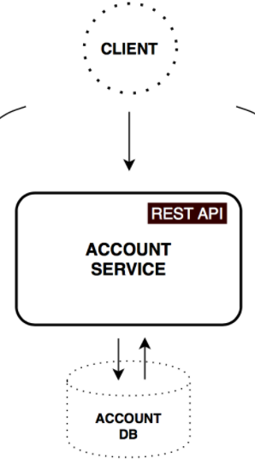
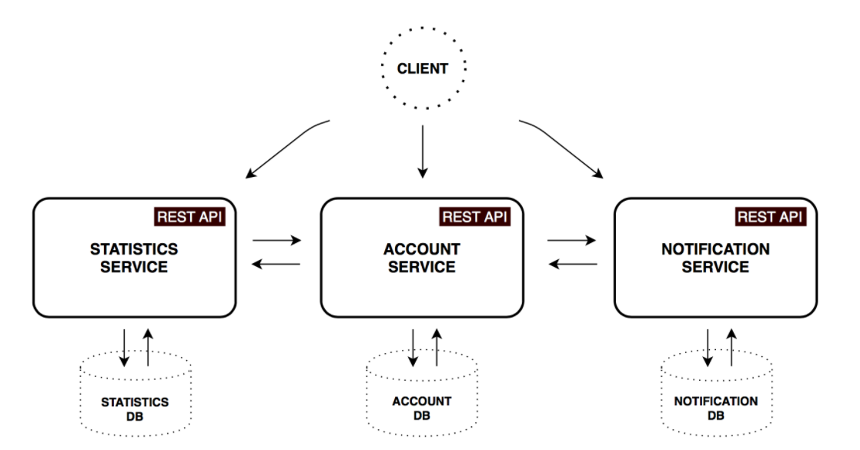
Core microservices

Slide 5
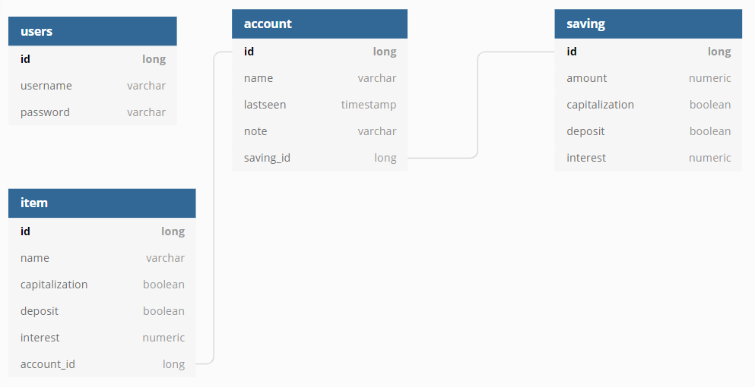
Database diagram

Slide 6
SWAGGER API: http://localhost:8080/my-custom-path
Method | Path | Description | Note
POST | ​/api​/finance | CREATE an account | Success
GET | ​/api​/finance​/account​/{name} | Get account data by account name | Success
PUT | ​/api​/finance​/saveChanges​/{name} | Update saving, income and expense from account | Failed, Error invoke subClass
PUT | ​/api​/finance​/updateSaving​/{name} | Update Saving | Success
SAVING | /api/finance/seeSaving/{name} | See Saving by account name | Success

Slide 7
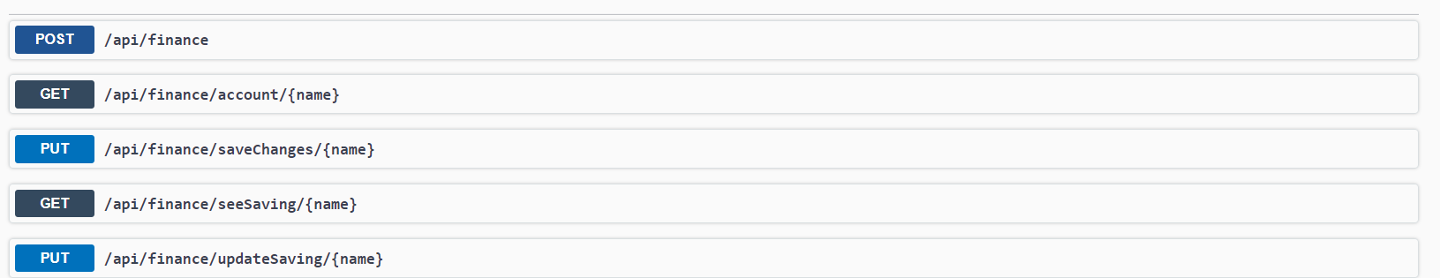
SWAGGER IMPLEMENTATION
https://localhost:8080/swagger-ui/my-custom-path

Slide 8
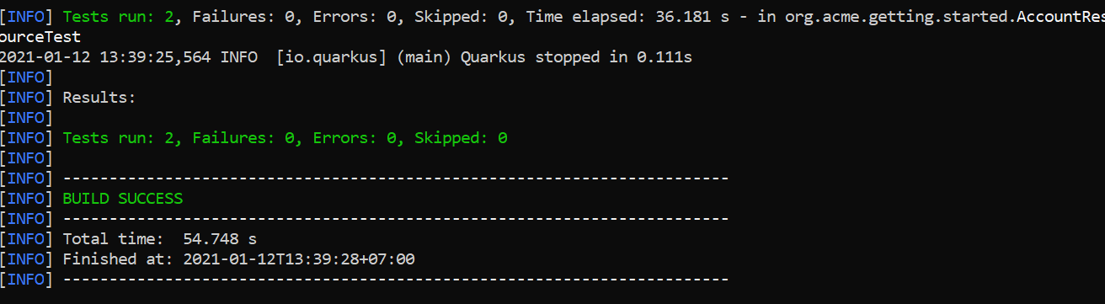
Quarkus testing
Testing for getAccountByName and CreateAccount

Slide 9
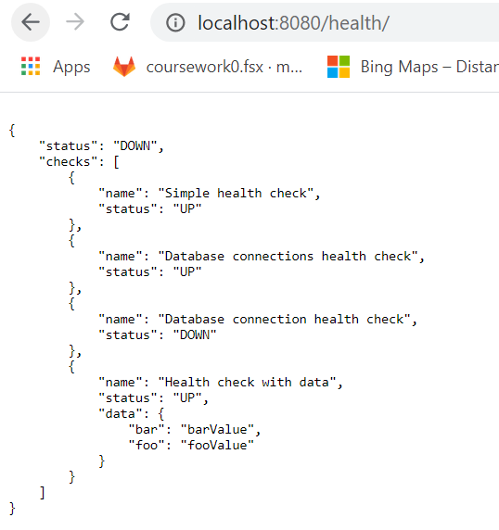
Health check services

Slide 10
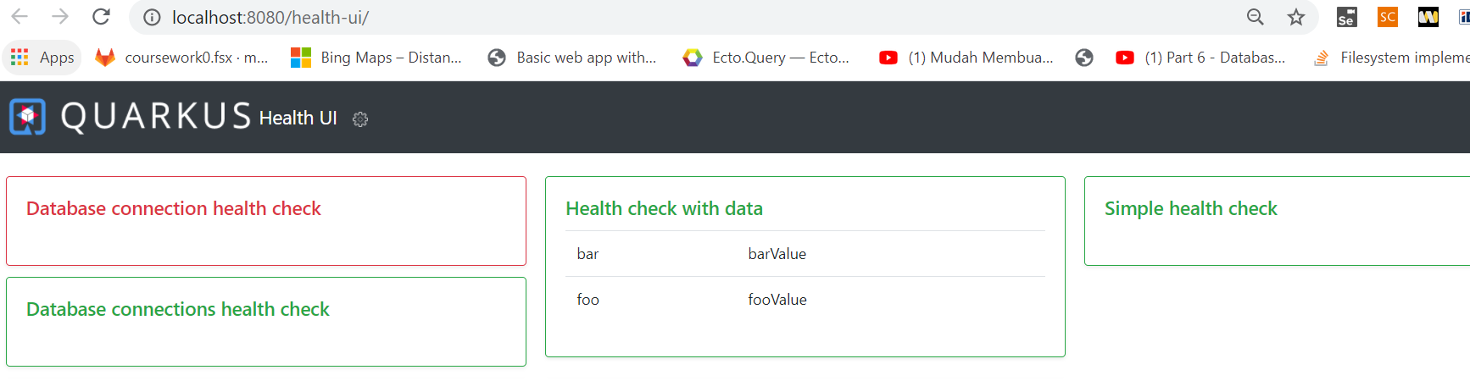
Health check services

Slide 11
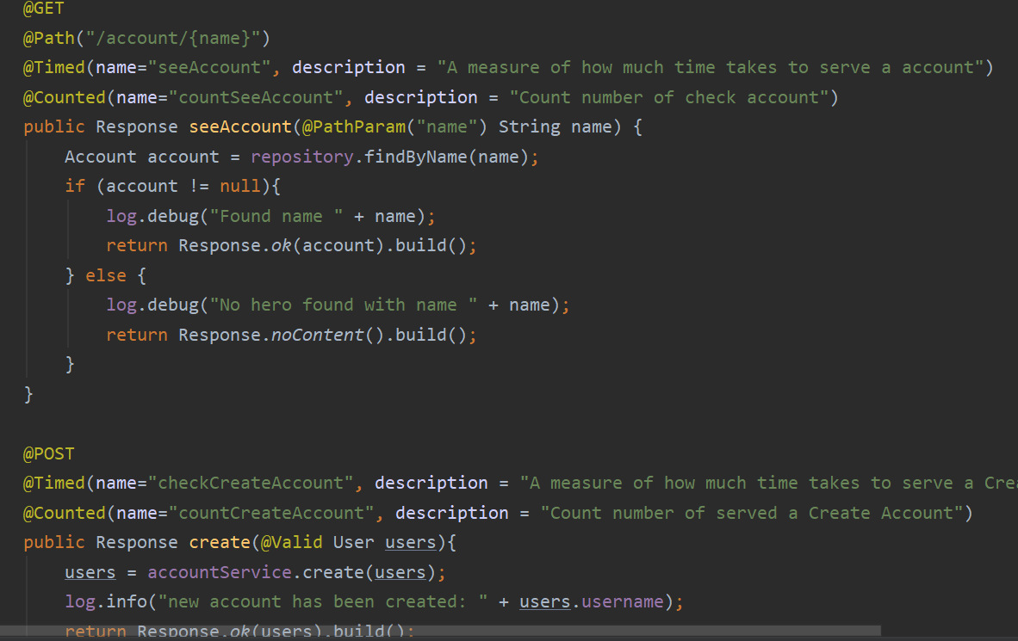
Monitoring part of service

Slide 12
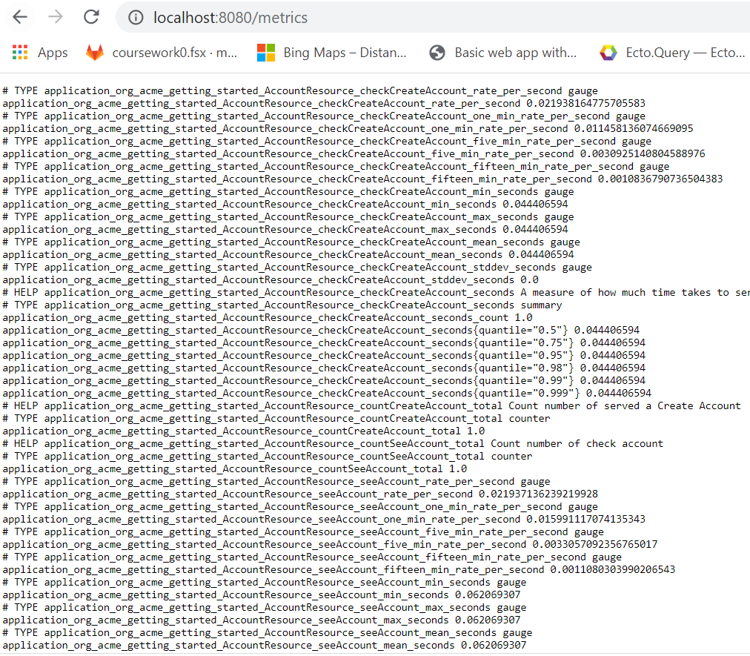
Monitoring part of service

Slide 13
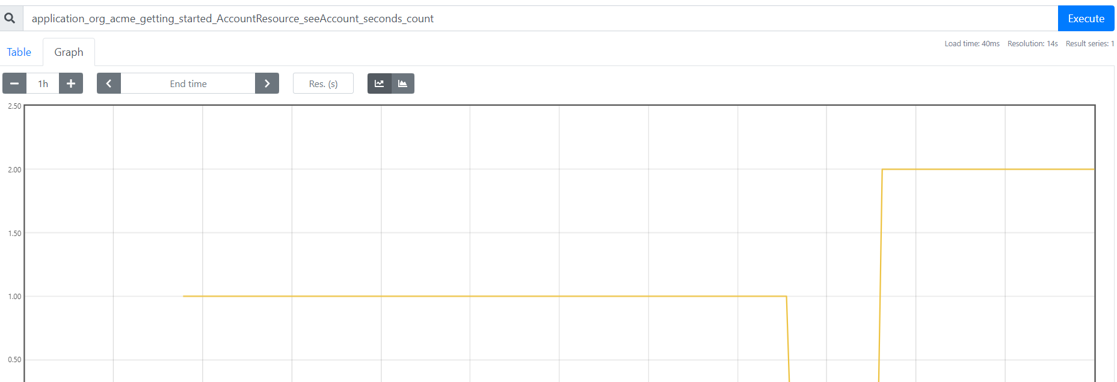
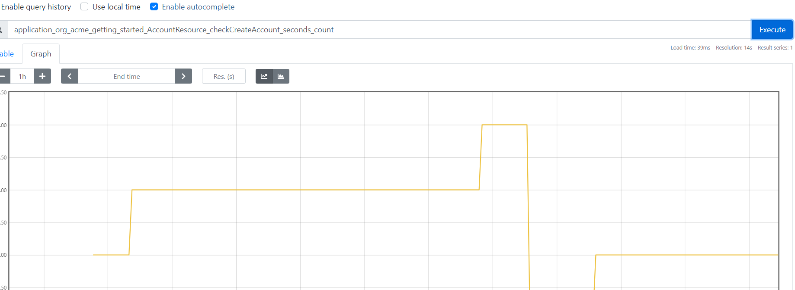
promotheus

Slide 14
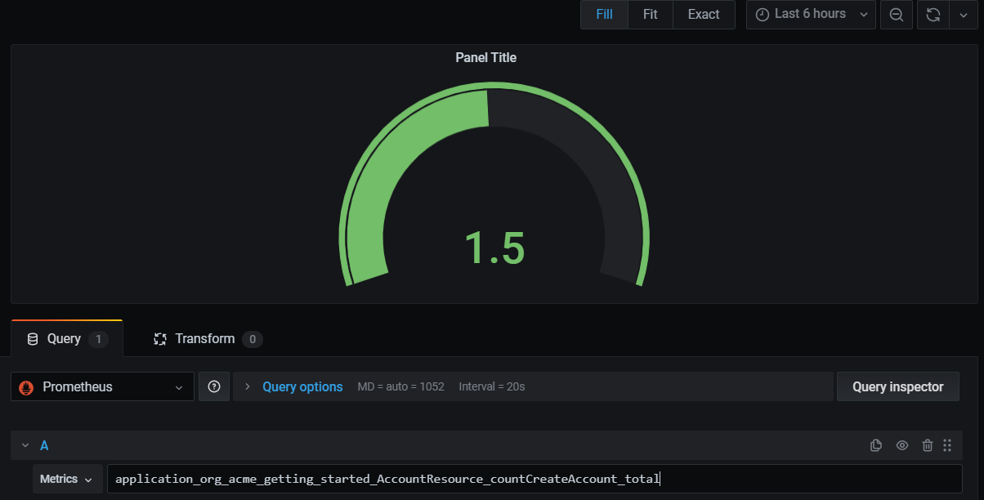
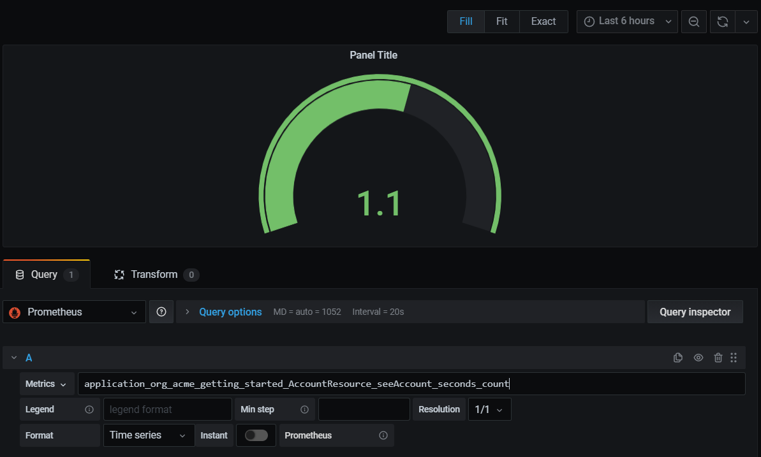
eXAMPLE OF Grafana

